Slide 1
Introduction to Machine Learning
© 2025 Virginia Polytechnic Institute and State University. All rights reserved.

Slide 2
Introduction to Machine Learning

Slide 3

Introductions
Notes:
Name
Role
Experience with machine learning (if any)
Expectations for the course

Slide 4
Introduction to Machine Learning

Slide 5
Course logistics
Introduction to Machine Learning
Day 1 Introduction to Machine Learning Resampling Methods Linear Model Improvements Nonlinear Models | Day 2 Classification Methods Tree-Based Methods Support Vector Machines | Day 3 Unsupervised Learning Deep Learning Reinforcement Learning (if time allows)
8:00am – 4:30pm each day with mid-morning, lunch & mid-afternoon breaks

Slide 6
Course materials & software
This course is a mixture of lecture and instructor-led coding activities
Materials include presentation slides (pdf), datasets (csv), and code (R or Python files)
Please ensure you have completed the following steps:
Download course materials from PDN (orange) Canvas
Unzip and locate course materials on your computer
Download and install R & RStudio or Anaconda (which includes JupyterLab and Python)

Slide 7
Course prerequisites
We assume you are familiar with:
R or Python
Importing a dataset
Coding basics
Creating statistical graphics
Statistical methods
Basic statistics
Simple linear regression
Multiple linear regression
Basic probability including Bayes’ rule

Slide 8
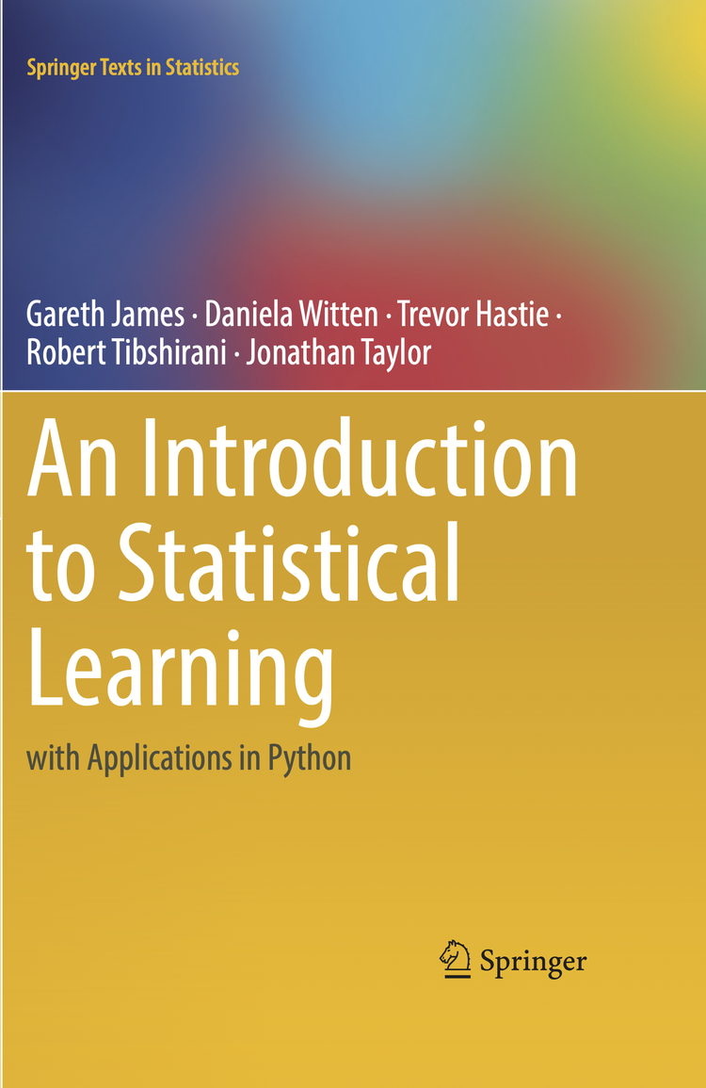
Course textbook
This course is based on An Introduction to Statistical Learning with Applications in Python¹ which is available free online https://www.statlearning.com/
The course will be delivered in a slightly different order than the text, but chapter references will be provided
¹Gareth James, Daniela Witten, Trevor Hastie, Robert Tibshirani, Jonathan Taylor. (2023). An introduction to statistical learning : with applications in Python. New York :Springer.
Notes:
The concepts presented in this course have been curated from An Introduction to Statistical Learning with Applications in Python by James, Witten, Hastie, Tibshirani, and Taylor. Note that the book is written for an audience that would include upper-level undergraduate and lower-level graduate data science related fields. If you want to learn more about the mathematics and statistics underneath the conceptual explanations in this material, we invite you to check out the book. Free versions are updated periodically for download online.
This course will be delivered in a slightly different order than the text, but chapter references will be provided
Also, note that many of the graphics in this course are copied directly or adapted from graphics in the book with permission.

Slide 9
Course objectives At the end of this course, you should be able to:
Describe general applications of machine learning
Understand the paradigms of machine learning related to model building and fitting
Apply commonly used supervised and unsupervised machine learning algorithms
Evaluate model quality based on a variety of appropriate metrics

Slide 10
Introduction to Machine Learning

Slide 11
At the end of this module, you should be able to:
Describe general applications of machine learning
Explain the difference between supervised and unsupervised learning
Explain the “train, validate, test” paradigm
Key point: When we evaluate the predictive capability of models, we will always use average TEST MSE and average TEST error rate.
Identify the tradeoffs between flexibility and interpretability
Describe the consequences of overfitting and underfitting
Identify overfitting and underfitting on plots of training and testing error rates

Slide 12

Artificial Intelligence (AI)
The theory & development of computer systems able to perform tasks normally requiring human intelligence, such as visual perception, speech recognition, decision-making, and translation between languages.
~ Oxford Languages
Notes:
Artificial intelligence is the entire system, machine learning are the algorithms behind the systems.

Slide 13
Artificial Intelligence (AI)
Natural Language Processing
Expert Systems
Machine Learning (ML)
Generative AI
Computer Vision
Algorithms that use statistics to find patterns in massive amounts of data. Data includes numbers, words, images, clicks, anything that can be digitally stored.
~ paraphrased from MIT Technology Review
Robotics
Speech Recognition
Notes:
Many types of AI – we will focus on machine learning
Artificial intelligence is the entire system, machine learning are the algorithms behind the systems.
Let’s look at some common applications of AI & ML
For info for the speaker to use in their comments if they want to:
Machine learning (ML) is the study of computer algorithms that improve automatically through experience.^{[1][2]} It is seen as a subset of artificial intelligence. Machine learning algorithms build a mathematical model based on sample data, known as "training data", in order to make predictions or decisions without being explicitly programmed to do so.^{[3]} Machine learning algorithms are used in a wide variety of applications, such as email filtering and computer vision, where it is difficult or infeasible to develop conventional algorithms to perform the needed tasks.
Machine learning is closely related to computational statistics, which focuses on making predictions using computers. The study of mathematical optimization delivers methods, theory and application domains to the field of machine learning. Data mining is a related field of study, focusing on exploratory data analysis through unsupervised learning.^{[5][6]} In its application across business problems, machine learning is also referred to as predictive analytics.
Wikipedia contributors. (2020, July 28). Machine learning. In Wikipedia, The Free Encyclopedia. Retrieved 15:37, August 4, 2020, from https://en.wikipedia.org/w/index.php?title=Machine_learning&oldid=969943713

Slide 14


ML algorithms enable personalized Alexa responses
Alexa, what is the temperature today?
It is 75°F. Happy Friday Vanessa!
Notes:
You may be interacting with machine learning models implemented in artificial intelligence applications on a daily basis. For example, these algorithms are used in smart assistants like Siri, Alexa, Cortana, or Google. These models are used to do things like identify your voice so your smart assistant can personalize the information he or she greets you with.
This is how Alexa recognizes Vanessa’s voice when she asks “Alexa, what is the temperature today?” and she responds “Its’s 75 degrees today. Happy Friday, Vanessa!”
In milliseconds, she matches the voice signature to the one we created during set up, decides that the Vanessa’s voice is the closest match, and then inserts his name into her “Happy Friday!” statement
Remember, artificial intelligence is the entire system, and machine learning is the algorithm behind the system.

Slide 15



ML algorithms determine credit card approvals
Notes:
Machine Learning algorithms determine credit card approval decisions
The look at your debt, your job stability, your credit history, etc. and determine if you are a good risk.

Slide 16

ML algorithms help you focus on important emails
Notes:
It is how Outlook knows how to sort your email into “Focused” email from your colleagues and “Other” email which includes promotional emails or mass emails from distribution lists.

Slide 17
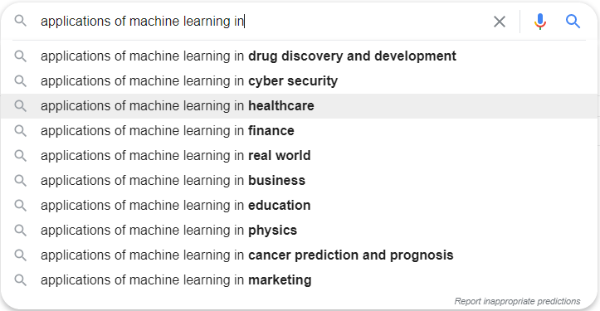
ML is being applied everywhere
As you go through this class, think about your data and where you might apply machine learning to problems you want to solve!

Slide 18
No matter the application, the goal of machine learning remains the same…
Does the patient have the disease?
Is this credit card fraud?
Which genetic and lifestyle factors are likely to lead to more severe illness symptoms?
Decision Making
Based on the electronically submitted resumes, who are the top candidates for this job?
Has the criminal’s license plate been spotted on a traffic camera?
What is the likely path and severity of the hurricane?

Slide 19
There are multiple categories of ML
Machine Learning (ML)
Reinforcement Learning
Supervised and unsupervised learning are the focus of this course
Deep learning & reinforcement learning will be introduced as time allows
Semi-supervised learning will not be covered
Unsupervised Learning
Supervised Learning
SSL
Deep Learning

Slide 20
Supervised versus unsupervised learning
Supervised
Unsupervised
We have “the answer” (i.e., outcome values or labels)
There is an output (or dependent variable or response) to predict
Examples:
Predicting risk of loan default
Train the model on data that includes financial records (inputs) and whether or not the person has defaulted (output)
Predicting visual defects in a material
Train the model on a set of manufacturing inputs (e.g., time, temperature, speed, etc.) and expert visual inspection results
We do not have “the answer”
There is not an output to predict, rather we are looking for patterns, relationships, or structure
Examples:
Customer segmentation
Survey customers on purchasing behavior, income, and demographics to determine if they are function-based purchases, impulse buyers, or high-tech enthusiasts
Clustering for evolutionary biology
Use DNA data to identify groups that align with evolutionary changes
Notes:
Let’s dive into some of the key aspects of machine learning that you will need to understand. First, you will need to know the difference between the two main categories of machine learning in this course - supervised and unsupervised learning.
In supervised learning, we have a dependent variable which might also go by the name “Y” or response, that we want to predict. In other words, we know the answer or the outcome for each instance in our data set and we want to create a model that will predict that answer or outcome on future data. Examples for supervised learning include predicting default or defects.
In unsupervised learning, we are interested in identifying patterns, relationships, or structures in our data set. In this case there is no “answer” or outcome we want to predict. We want to look at the results of machine learning output and interpret it in the context of subject matter expertise. Ultimately, we might use the outputs of these patterns in order to make a decision but it is usually in the context of human interpretation that would then be implemented into an AI system. Examples for unsupervised learning involve creating customer segments and clustering DNA groups.

Slide 21
Supervised versus unsupervised again
Some tangible measurement(s)
“The Black Box”
INPUTS
MACHINE LEARNING MODEL
OUTPUT(S)
Supervised Learning
In the context of domain knowledge
“The Black Box”
INPUTS
MACHINE LEARNING MODEL
PATTERNS,
RELATIONSHIPS, STRUCTURE
Unsupervised Learning
does it make sense?
Notes:
Here is another look at supervised versus unsupervised learning. Both of these techniques have inputs. Both employ machine learning models. However, you are predicting a specified output in supervised learning that is a tangible measurement. In unsupervised learning, you are interested in identifying patterns, relationships, and structure in the context of domain knowledge. Unsupervised learning often creates groups of similar items that a subject matter expert can interpret in the context of their domain knowledge. Other types of unsupervised learning can take a large number of variables or inputs and reduce them to a manageable number of interpretable concepts. For example, we might be able to reduce thousands of variables in a tax database to representative constructs of a taxpayer. These constructs might include new variables representative of income, family, charitable giving, medical expenses, etc. just to name a few.

Slide 22
Supervised learning method selection is based on the response type
Is my response quantitative or qualitative?
Age
Height
Income
Stock Price
Tensile Strength
Quantitative
Qualitative
Blood Type
Default on Debt (y/n)
Cancer Stage
Brand Purchased
Species
Typically use regression method
Typically use classification method
Discrete: Nominal or Ordinal
Continuous Measures
What about the predictors?
For most methods, predictors can be
either quantitative or qualitative.
Notes:
Typically we use the term regression method to refer to any supervised learning model that helps us predict or make inferences about a continuous response. You may be familiar with linear regression from previous training but note there are many other types of models that fall under the category of regression.
On the other hand, we use the term classification method to refer to any supervised learning model that helps us predict or make inferences about a categorical response. The categorical response might be nominal as in the case of different types of blood or the response might be ordinal as in stage of cancer.
We will provide overviews of many types of regression and classification models in subsequent modules. ​

Slide 23
Introduction to Machine Learning Course Roadmap
What is the goal of the data analysis?
Predict an output |  |  |  |  |  | Reveal patterns or relationships |  | Make decisions using an autonomous agent
Supervised Learning (Output in the data set) |  |  |  |  |  | Unsupervised Learning (No output in the data set) |  | Reinforcement Learning* (Supervised & unsupervised)
Continuous or discrete output? |  |  |  |  |  | What is the subgoal? |  | Does a model exist?
Continuous |  |  | Discrete |  |  | Identify groups | Reduce dimensions | Model Based | Model Free
Simple linear regression Multiple linear regression Subset selection Ridge regression & LASSO PCR & PLS | Polynomial regression Step functions Splines Local regression General additive models | Decision tree Random forest Neural network Gradient boosting tree | Logistic regression Linear discriminant analysis Quadratic discriminant analysis | Decision tree Random forest Neural network Gradient boosting tree | Support vector machines | Hierarchical clustering K-means clustering | Principal components analysis | Given the model Learn the model | Policy Optimization Q-Learning
*Advanced Topic: Bonus module if time
Notes:
This course roadmap gives a nice overview of the machine learning algorithms we will cover in the following training modules. However, we want you to be aware of the ever-evolving landscape of machine learning. It is important to keep up to date on new algorithms. The modules supplied here will give you a great foundation for expanding that knowledge.

Slide 24
Introduction to Machine Learning

Slide 25
Example: Predicting sales from advertising budget
Business question: How should we adjust our advertising budget to increase sales?
ML goal: Develop an accurate model that can be used to predict sales based on three media budgets (tv, radio, newspaper)
Inputs:
TV Budget
Radio Budget
Newspaper Budget
MACHINE LEARNING MODEL
Outputs: Predicted Sales
Dependent Variable or Response or Y
Independent Variables or Predictors or Xs
Also called Features in Machine Learning
Notes:
Let’s start with an example of supervised learning that you may be able to relate to…
.
We have a business question related to adjusting advertising budgets to increase sales. In this case our dependent variable or output is sales and our inputs are budgets for tv, radio, and newspaper. You might be chuckling about the older nature of the budget types but maybe you should think of tv as streaming services, radio as satellite radio, and newspaper as the online version of your favorite new source.
This is an example of supervised learning because we have an output we are trying to predict.
What type of ML model comes to mind?....Simple or multiple linear regression

Slide 26
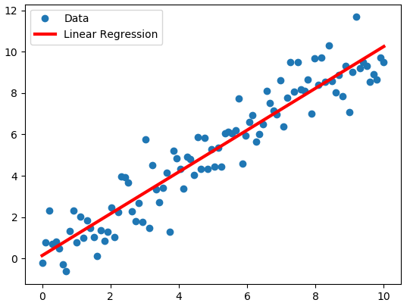
Linear regression is supervised ML you likely have done before
A linear regression model is an equation that describes the linear relationship between a continuous response variable (y=dependent) and one or more continuous input variables (x=independent).
If there is one x variable, it is referred to as a Simple Linear Regression (SLR).
If there is more than one x variable, it is referred to as Multiple Linear Regression (MLR).
Y
X
Notes:
You’ve done machine learning before if you’ve done simple or multiple linear regression.
In fact, fitting supervised models will follow the same schema as SLR, often minimizing some loss function.
Simple linear regression is used to evaluate relationships between a continuous and Y and a single continuous X. While multiple linear regression extends to more than one x
In the figure seen here, the data points are the blue dots. The red line is the “line of best fit” for our linear regression model.

Slide 27
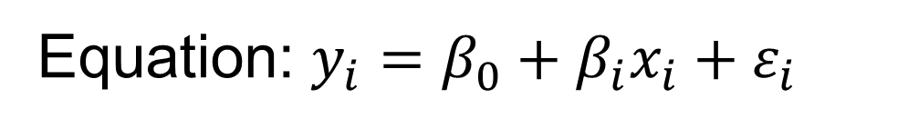
The SLR straight line model
Equation: $y_{i}=β_{0}+β_{i}x_{i}+ε_{i}$
Slope (β₁) determines steepness and direction (up or down) of the trend; rate of increase in Y with respect to X.
Y
The relationship between X and Y “disappears” when slope = 0
X
Intercept (β₀) = predicted Y-value when X = 0
Notes:
Recall the parameters or characteristics of the line we are trying to estimate and what they represent
You may remember from algebra the equation of a straight line using the intercept and slope. The slope, or “beta one” as seen in the equation, determines the steepness and the direction (either up or down) of the trend. It determines the rate of increase in Y with respect to X.
This straight-line model is important because this what we are fitting to our data when we preform simple linear regression. Software can find the “best fit” line through our data and provide values for the slope and intercept that we can use to make decisions about our data. The slope is particularly useful because it directly characterizes the relationship between X and Y. For every unit increase in X, Y changes by a factor of beta1. The sign of beta1 determines whether Y decreases (if beta1 is negative) or increases (if beta1 is positive) with an increase in X. When the slope = 0, the relationship between X and Y “disappears”.
We need to statistically test if there exists a relationship between X and Y, which can be done by testing the appropriate hypothesis.

Slide 28

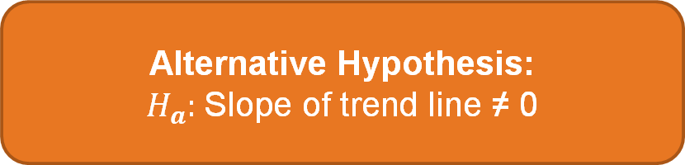
SLR possible hypotheses
Based on my sample, can I conclude there is no straight-line relationship between X and Y?
v.s.
Or do I think there is a straight-line relationship between X and Y?
Notes:
This is exactly what simple linear regression is testing. Remember, “The null is dull!” The null is the status quo. Statistical theory has us write the null as an “equal to” hypothesis. The null assumes that the slope of the “best fit” line is zero. You might remember that a horizontal line has a slope of 0 from previous mathematics or statistics courses. Another way we can think about it is that there is no straight-line relationship between X and Y. The mean is the best indicator of the relationship. It’s boring because Y doesn’t change with X. The alternative is what we want to prove. It will create some excitement. The alternative hypothesis states that the slope is not equal to zero.
Transition to next slide: Now how do we estimate

Slide 29
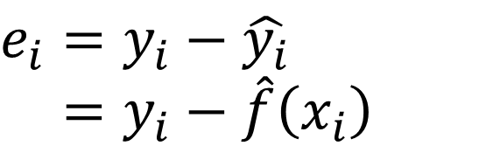
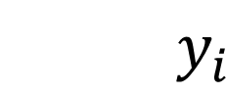
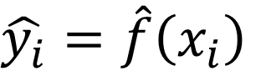
The residual from SLR
The blue dots are actual data
Fitted values are on the red line
$$y_{i}$$
$$\hat{y_{i}}=\hat{f}\left(x_{i}\right)$$
The Residual
The difference between the actual & fitted (or predicted) value. Every point on the plot has a residual. Examples shown by orange lines.
Y
$$e_{i}=y_{i}−\hat{y_{i}} \\ =y_{i}−\hat{f}\left(x_{i}\right)$$
X
Notes:
We need to understand the residual which is a key component of our equation. The distance from the point to the line is called a residual. It is the difference between predicted versus actual. We get the line of best fit by choosing the line that minimizes the sum of these squared residuals.
point out that residuals are small when we have points close to the line and large when the are further away
Quantify the extent to which the predicted response value for a given observation is close to the true response value for that observation.

Slide 30
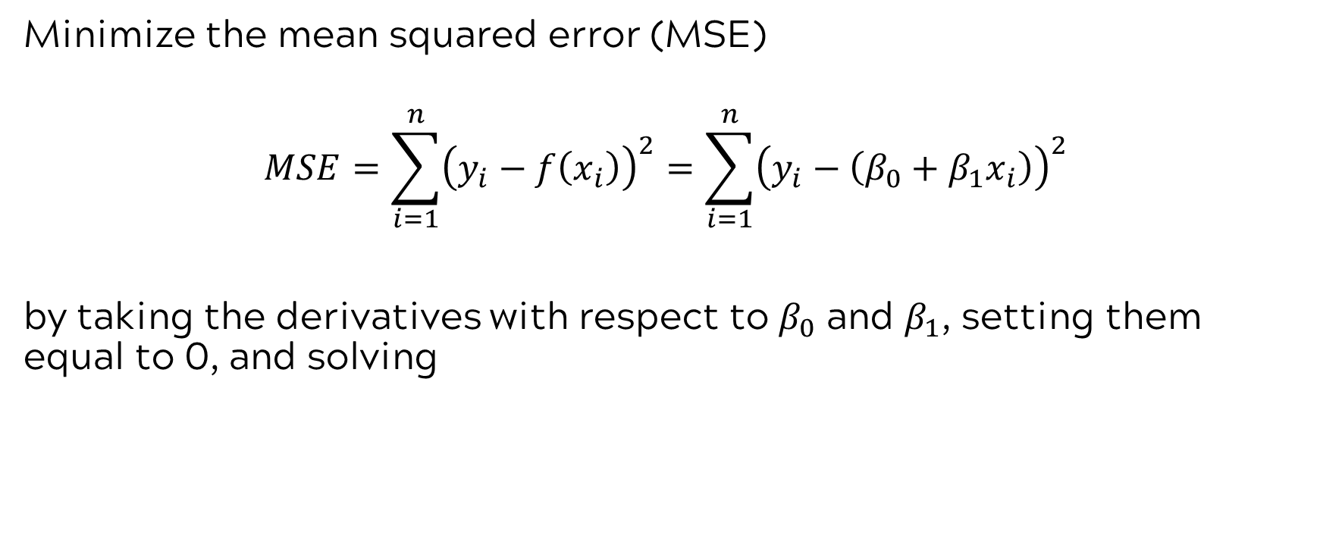
SLR intercept and slope estimates minimize MSE
Minimize the mean squared error (MSE)
$$MSE=\sum_{i=1}^{n}{{\left(y_{i}−f\left(x_{i}\right)\right)}^{2}}=\sum_{i=1}^{n}{{\left(y_{i}−\left(β_{0}+β_{1}x_{i}\right)\right)}^{2}}$$
by taking the derivatives with respect to $β_{0}$ and $β_{1}$, setting them equal to 0, and solving
KEY IDEA: Most machine learning algorithms work on a similar principle of minimizing or maximizing some objective function to find the “best” model.
Notes:
Refresh on SLR estimation. Focus on connection to what they are about to learn with minimizing and maximizing.
Great question. While not all machine learning algorithms explicitly minimize or maximize a function, most do—especially in the context of training or optimization.
Here’s a breakdown:
Algorithms That Do Optimize a Function
These typically aim to minimize a loss function (or maximize a utility function) to find the best model parameters:
Supervised learning
Linear regression: minimizes mean squared error
Logistic regression: minimizes cross-entropy loss
Neural networks: minimize some form of loss function via gradient descent
Support vector machines: minimize a hinge loss (with regularization)
Unsupervised learning
K-means clustering: minimizes within-cluster variance
PCA: maximizes explained variance, or equivalently minimizes reconstruction error
Reinforcement learning
Maximizes expected cumulative reward (policy optimization or value function)
Probabilistic models
Often maximize the likelihood (or posterior), e.g., Naive Bayes, Hidden Markov Models
Algorithms That May Not Explicitly Optimize a Function
Some algorithms don't involve a clearly defined global optimization objective:
Decision trees (e.g., CART):
They use greedy splitting criteria (like Gini impurity or information gain), but this is not a global optimization.
Each step chooses the locally best split—there's no single loss function minimized across the whole tree.
Rule-based systems or heuristics:
These often follow logic or rules that don’t arise from optimizing a continuous function.
Some ensemble methods (like Random Forests):
They combine many models that individually use local heuristics. The ensemble as a whole isn’t trained via a single optimization routine.
Summary
Most modern machine learning techniques do involve optimization—they minimize a loss function or maximize some objective.
Some classic or heuristic-based methods don’t fit this paradigm as neatly but still rely on principles that approximate optimization (e.g., greedy search).
If you're looking at machine learning from a statistical learning or optimization lens, the idea of minimizing or maximizing an objective function is an excellent mental model—but it has a few exceptions.

Slide 31
Back to our ad & sales example. What can we learn through pictures?
Notes:
Different scales on x-axis
Which relationship is the strongest?
Which is the weakest?
How would we use these variables to predict?
The most important statistical test is the look test. We plot our data to learn though pictures. As you can see, we have positive relationships or correlations with sales and all three of the advertising budget types. We can also see that the variability of sales tends to increase with TV and Radio expenditures but is relatively constant with newspaper. The Sales and TV relationship may have some non-linearity on the low end of the scale.

Slide 32
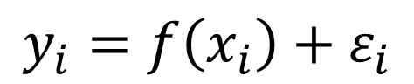
Another example of an X-Y relationship, but this relationship is not linear
$$y_{i}=f\left(x_{i}\right)+ε_{i}$$
Notes:
Another case might include estimating your income from years of education. We can certainly see some non-linearity here.
Now, if you are thinking, “Wow! This looks a lot like linear regression or regression with some more complicated model” then you would be correct! You might even think of regression as fitting a trend to the data. Regression is just one form of machine learning model that has been around for a long time. It is great to start with something that is familiar.
Output = Y = Income
Input = X = Years of education
There are many ways to estimate the curved shape seen here. Some of them would include adding polynomial terms or other types of models like splines, GAMS, etc.

Slide 33
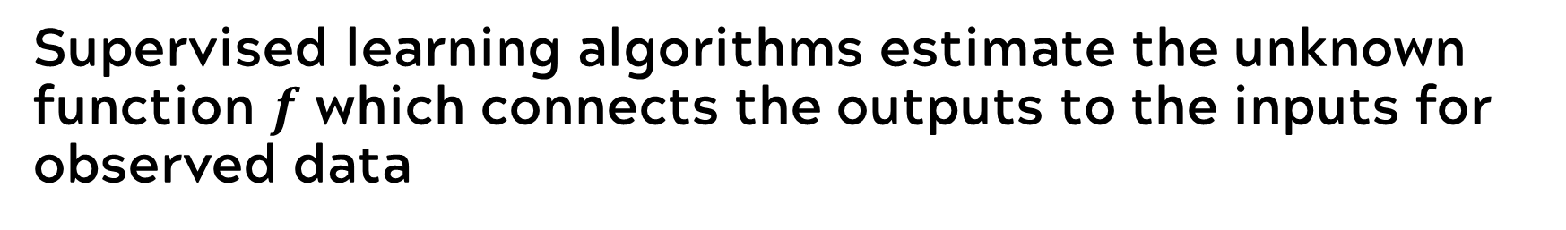
Supervised learning algorithms estimate the unknown function $f$ which connects the outputs to the inputs for observed data
INPUTS
MACHINE LEARNING MODEL
OUTPUT(S)
X
f(X)
Y = f(X) + ε
Y
a set of p different predictors, X₁, X₂, … , X_{p}
f is some fixed but unknown function of the Xs that represents systematic information that X provides about Y
Y is the observed response
ε is a random error term, independent of X with mean 0
Notes:
Let’s review the idea of modeling. Basically, a supervised learning model will take the inputs and create a function. That function includes a portion f(X) that we estimate from the data. It represents systematic information that X provides about Y. However, each individual observation is going to have departures from the model fit/prediction. These departures from the model will show up in the form of epsilon or our model error. In a regression model, you may remember that we require our errors to be independent and have a mean of zero. Depending on the type of regression model we fit, there may be additional assumptions about the distribution of those errors, like normality. However, know that there are many different types of regression, each with a different error distribution model.
Function f that connects the input variable(s) to the output variable is generally unknown estimate f based on observed data points
We can think of statistical learning as a set of approaches for estimating f

Slide 34
Paradigm for ML, regardless of the algorithm
TRAIN
VALIDATE
TEST
Use the training subset to fit the initial model
Use the validation subset to evaluate & tune the model
Use the testing subset to get an unbiased evaluation of the final model
Notes:
Let’s go back to our sales and advertising example. If we want to fit a predictive model in the context of machine learning, we are going to do it with the Train-Validate-Test paradigm. This paradigm provides us with some ways to check and adjust our model as well as a more objective way to evaluate it.
This involves dividing our data randomly into three different data parts. We will use one to train the model. We will use the second to validate the model and the third to test the model.
Our training data set will be put into a software package or coding language to create that initial estimate of f(X). During validation, we may fit that same model on the validation set and then fine tune the parameters in the model. We might adjust them up or down a bit to improve the model performance. Then, we use the testing data set to get an unbiased final evaluation of the model on the data. Note that this testing set is data the model has never seen before. In this step we assess various metrics about model performance to see if they are satisfactory for using our model in practice. This makes a lot of sense because machine learning models in action derive their value from making predictions on data they have not seen before.
Note that sometimes the validation step will be eliminated because there is not enough data or time or no reason to fine tune the model. Also, some data scientists use validate and test interchangeably. Don’t get hung up on jargon. Just make sure as a manager that your team satisfies the spirit of this process by tweaking the model if required and testing it on data that was not used to fit the model.
Emphasize - This course will focus mainly on Train and Test
Analogy: Training is like setting up for a large dinner party--- the wait staff lays out the table linens, the china, the silverware, and the glassware. Validation is when the head waiter comes through and adjusts the spacing of the glassware and china and straightens the silverware to make some minor improvements to the table layout

Slide 35
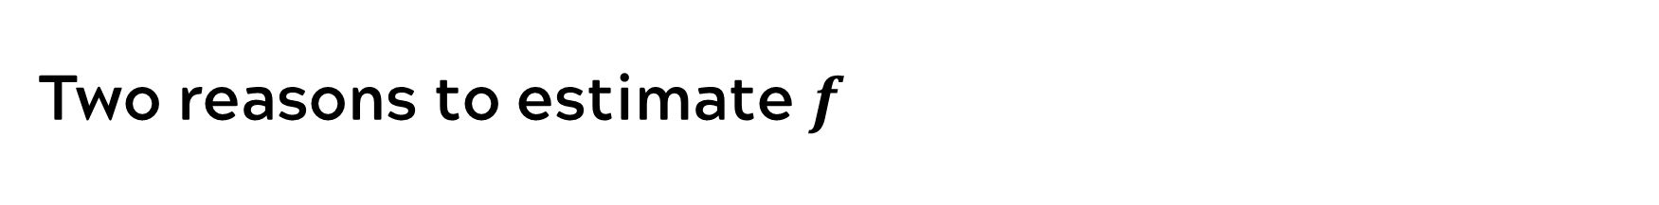
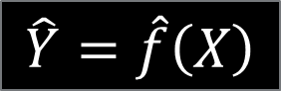
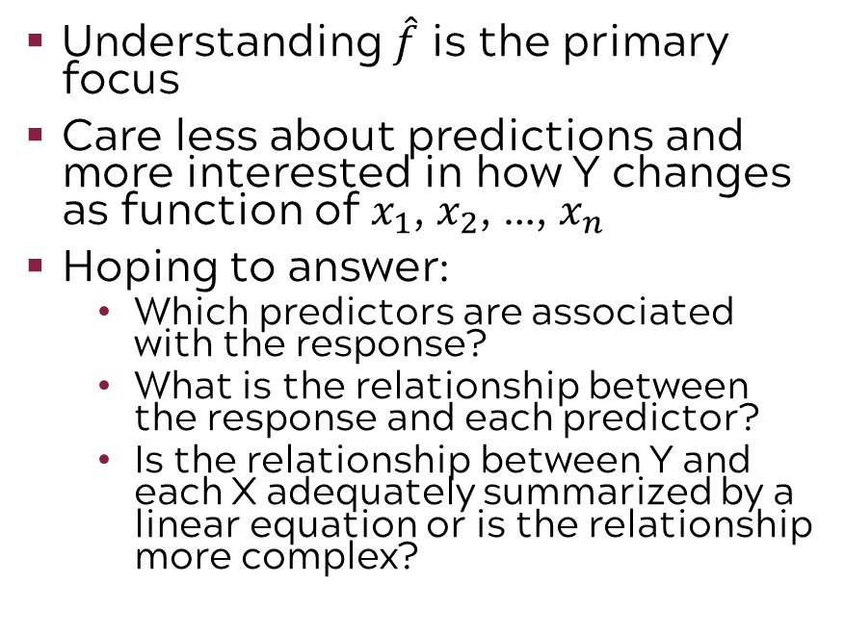
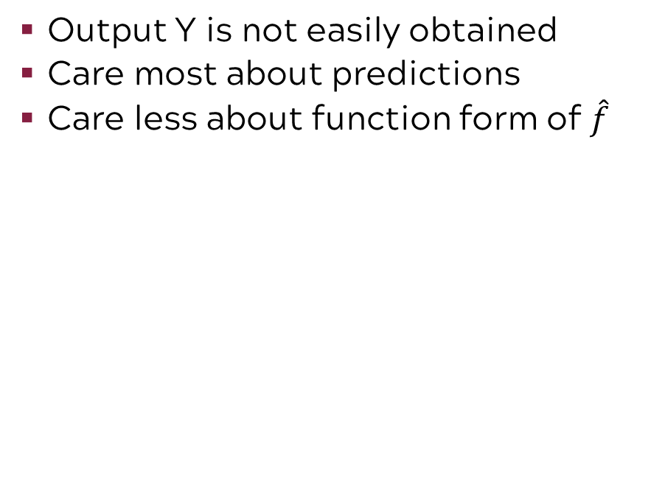
Two reasons to estimate $f$
Prediction
$$\hat{Y}=\hat{f}\left(X\right)$$
Inference
Output Y is not easily obtained
Care most about predictions
Care less about function form of $\hat{f}$
Understanding $\hat{f}$ is the primary focus
Care less about predictions and more interested in how Y changes as function of $x_{1}$, $x_{2}$, …, $x_{n}$
Hoping to answer:
Which predictors are associated with the response?
What is the relationship between the response and each predictor?
Is the relationship between Y and each X adequately summarized by a linear equation or is the relationship more complex?
Notes:
We have two reasons for estimating a machine learning function through the Train-Test-Validate paradigm. One of them is prediction and the other is inference.
For a predictive model, we primarily care about the accuracy and precision of the output. The underlying relationships that govern the effect of the changes in Y as a result of changing X just aren’t as important.
However, if we want to make some inference about the nature of the relationship of X and Y, we may need an inferential model. Inferential models do allow us to assess the impact of X on a Y. We can specify the type of relationship and even interpret the magnitude or direction of the impact of X on Y. Note that inferential models do not imply causation.
Back to our advertising and sales example, if we only want to make a sales forecast based on amounts already committed then we may not care about the type of relationship, magnitude, or direction of the TV, radio, and newspaper amounts. However, if we want to optimize next year’s budget then we would want to understand the impact of each budget on our sales.
Note that one of these reasons is not “better” than another in the machine learning world. Prediction and inference are both valid and useful reasons to employ machine learning. However, it is important to specify that goal upfront. Why? Some supervised machine learning algorithms are better at prediction, and some are better at inference. In fact, some predictive models are more of a black box type of model with no insights or very complicated insights into the relationships between the predictors and the outputs.
Bottom line: Know your goal from the start.

Slide 36
What is your goal? Prediction, inference, or both?
Prediction
Inference
Both
Practical Question: A company is going to conduct a direct marketing campaign. Who will respond positively to a mailing?
Why is this prediction? Company only interested in accurate prediction, not a deep understanding or relationships
Practical Question: Medical researchers want to understand which treatments affect time on a ventilator for a respiratory illness. How can we reduce the amount of time on the ventilator?
Why is this inference? Researchers need to understand the relationship of time on the ventilator with the type, amount, and delivery intervals of each treatment.
Practical Question: An engineer wants to understand which process conditions are associated with “in-spec” product. How can we increase the amount of good product?
Why is this both? The engineer needs to both predict the outcome in various operating windows and understand how to achieve it in order to adjust the process.
Notes:
Let’s look at the concepts of prediction and inference through the lens of some examples:
First we will consider prediction only. (click)
Next we will consider inference only. (click)
Finally, let’s look at an example where both inference and prediction might be important. (click)
Yes for the inference question a clinical trial might be best but given the gravity of the implications, that may not be possible early on in investigations. Historical data like this might be used to inform more planned clinical studies.
In the both example for process conditions, experiments would be the best approach but may not be possible because companies often do not have pilot lines and cannot use time on production assets to perform experiments. This is especially true if they are sold out.

Slide 37
Two methods of estimation
Parametric
(Less Flexible, More Interpretable)
Non-parametric
(More Flexible, Less Interpretable)
Inference focused
Select a model which involves an assumption about the functional form of f. Train the model and estimate parameters.
Example:
f is linear in X: f(X) = β₀+β₁X₁ + β₂X₂ +…+ β_{p}X_{p}
Prediction focused
Does not make explicit assumptions about the functional form of f. Can fit wider range of possible shapes for f, but at that cost of needing a larger number of observations.
Example:
Splines
Notes:
How do we accomplish prediction versus inference? The goals of prediction versus inference often align with the idea of a non-parametric model versus a parametric model. What’s the difference?
Non-parametric models are often more flexible and less interpretable. Characteristics of these models include
A prediction focus
They do not make explicit assumptions about the functional form of f
Can fit wider range of possible shapes for f, but at that cost of needing a larger number of observations.
Splines, which we will discuss in a subsequent module are an example of a non-parametric model
Picture a curve with lots of peaks and valleys. A non-parametric model might be great at approximating the shape of the curve and allowing you to make predictions. However, the smoother behind the curve is not something that can be cleanly expressed with mathematics or statistics.
Parametric models are less flexible but more interpretable. In this case, we select a model that specifies the functional form of X as shown in the example on the slide. We train the model in order to estimate the betas which allows for inference and interpretation on the strength, magnitude, and direction of the relationship of the X’s. These are more traditional regression models or econometrics models that you might be familiar with.
Estimate of f that gets as close to the data points as possible without being too wiggly.
More flexible in capturing nuances of data but require larger n

Slide 38
Trade-off between flexibility and interpretability
INTERPRETABILITY
Flexibility
Interpretability
And vice versa!
FLEXIBILITY
Notes:
This chart summarizes one of the key points of model fitting in the machine learning context. As flexibility increases, interpretation decreases.
You need to know your goal going into the modeling project in the context of what you gain or lose from a more interpretable model.

Slide 39

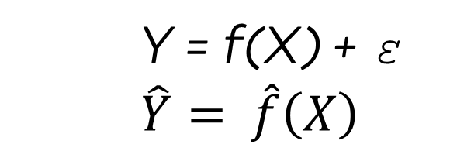
Model fitting basics: Error
Total Error
Reducible Error
Irreducible Error
We want accuracy but our model predictions will not be perfectly on target with observed data.
We can reduce by using the most appropriate algorithm to estimate f.
We will introduce many metrics and methods for assessing the appropriateness of the model.
We cannot reduce ε by using the most appropriate algorithm to estimate f.
ε may contain unmeasured variables that would be useful in predicting Y or unmeasured variation (e.g., individual variation from day to day).
Y = f(X) + ε
$$\hat{Y}= \hat{f}\left(X\right)$$
Notes:
We have talked about some basic characteristics of f(X), the model that we are estimating with respect to prediction and inference and flexibility and interpretability. Now, we need to discuss error. It doesn’t take an experienced data scientist to latch on to the concept that you want to select a model with the lowest error possible. After all, we know our predictions won’t be perfectly on target but having them be as close to on-target as possible is desirable.
The total error from our model can be broken down into two types: Reducible error and irreducible error. Reducible error is a type of error that we have some control over. We can select the best algorithm and, even within an algorithm type, we can change some settings in order to reduce error. We will accomplish this by trying multiple models and assessing multiple metrics on these models which will determine the most appropriate one.
Irreducible error is error that is not affected by our choice of machine learning algorithm. It is simply part of our system or process. Examples of irreducible error include useful variables for predicting or explaining Y that are not or cannot be measured.
Example: Irreducible error -predicting employment retention- we didn’t have employment history so we couldn’t reduce that error; some data are highly variable and we can’t account for all possible factors; biological scientists face these challenges as do folks in marketing and sales.

Slide 40
Introduction to Machine Learning
Notes:
It is important for you to understand the basic concepts for evaluating machine learning models so you can select the best one to use. We will introduce the concepts here that build the foundation for evaluating models on a continuous response, often described as “regression models” in machine learning.

Slide 41
Supervised learning method selection is based on the response type
Is my response quantitative or qualitative?
Age
Height
Income
Stock Price
Tensile Strength
Quantitative
Qualitative
Blood Type
Default on Debt (y/n)
Cancer Stage
Brand Purchased
Species
Typically use regression method
Typically use classification method
Discrete: Nominal or Ordinal
Continuous Measures
What about the predictors?
For most methods, predictors can be
either quantitative or qualitative.
Notes:
Recall that regression methods to refer to any supervised learning model that helps us predict or make inferences about a continuous response.

Slide 42
Model fitting basics: Error
Total Error
Reducible Error
Irreducible Error
We want accuracy but our model predictions will not be perfectly on target with observed data.
We can reduce by using the most appropriate algorithm to estimate f.
We will introduce many metrics and methods for assessing the appropriateness of the model.
We cannot reduce ε by using the most appropriate algorithm to estimate f.
ε may contain unmeasured variables that would be useful in predicting Y or unmeasured variation (e.g., individual variation from day to day).
Y = f(X) + ε
$$\hat{Y}= \hat{f}\left(X\right)$$
Notes:
Recall this slide from a few minutes ago, we want to reduce error. Let’s take a look in the context of regression

Slide 43
The residual from SLR
The blue dots are actual data
Fitted values are on the red line
$$y_{i}$$
$$\hat{y_{i}}=\hat{f}\left(x_{i}\right)$$
The Residual
The difference between the actual & fitted (or predicted) value. Every point on the plot has a residual. Examples shown by orange lines.
Y
$$e_{i}=y_{i}−\hat{y_{i}} \\ =y_{i}−\hat{f}\left(x_{i}\right)$$
X
Notes:
Recall a residual is the difference between the actual data value we observed and the model prediction we created from our machine learning algorithm. In our diagram our actual data points are the blue dots and our residuals are represented by the orange lines that extend from the dots to the red fitted line. While we have highlighted the definition of a residual using a simple linear model on this slide, this definition of a residual applies for any model that predicts a continuous variable.

Slide 44
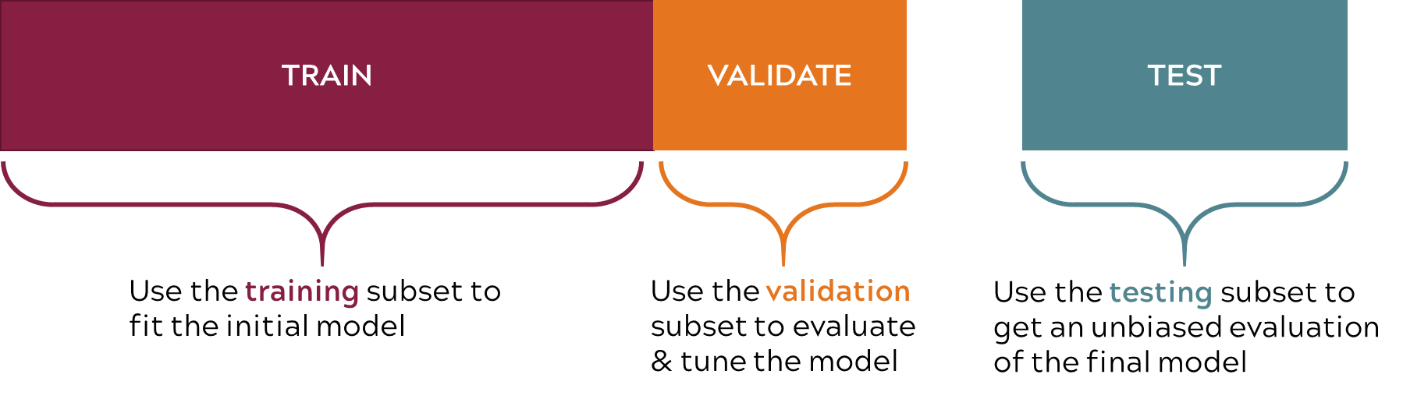
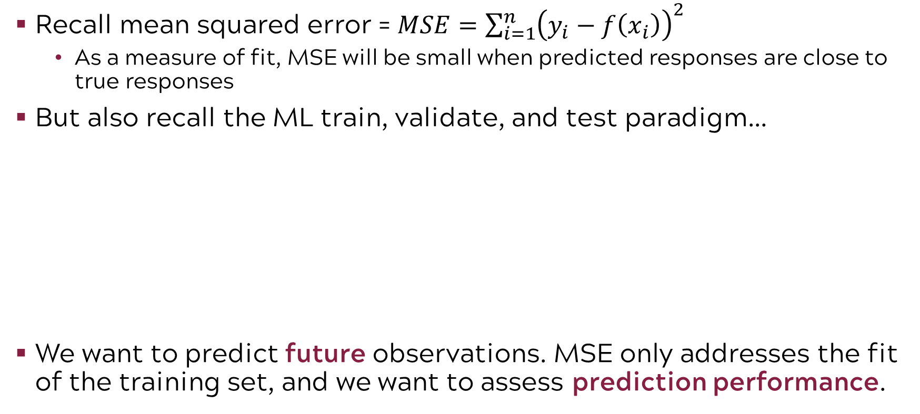
In regression, we use MSE to evaluate fit
Recall mean squared error = $MSE=\sum_{i=1}^{n}{{\left(y_{i}−f\left(x_{i}\right)\right)}^{2}}$
As a measure of fit, MSE will be small when predicted responses are close to true responses
But also recall the ML train, validate, and test paradigm…
We want to predict future observations. MSE only addresses the fit of the training set, and we want to assess prediction performance.
What metric will allow us to assess prediction of future values?
Notes:
We will use a metric based on the residual in context with the Train-Validate-Test paradigm, one of the big ideas of machine learning that we covered earlier, to assess the fit of our model. What do we mean by fit? We mean how well the model captures the relationship between the response and the predictors.
A metric that you may be familiar with from regression is the mean-squared-error, or the MSE. MSE quantifies the difference between the true responses and the predicted ones for the entire model. The lower the MSE the better the model fit to the data. The higher the MSE the worse the model fit to the data.
MSE is calculated for the training data. And therein lies a concern. In a machine learning situation, we are often interested in how the model predicts future observations. MSE only addresses model fit in the training set. We want to address model fit for prediction. We will use the Train-Validate-Test data sets to help us with this issue.

Slide 45
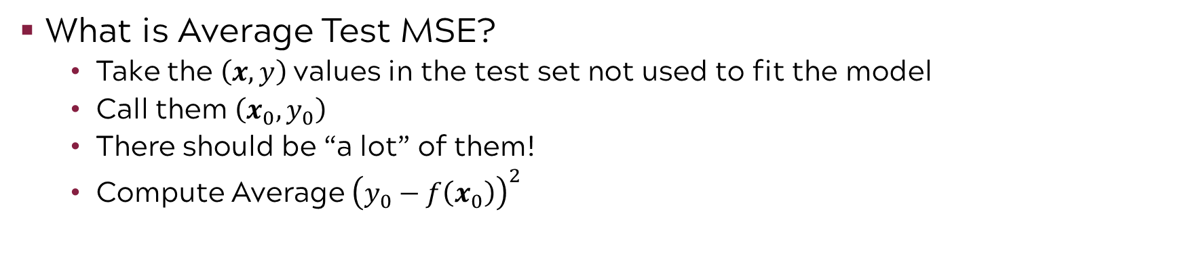
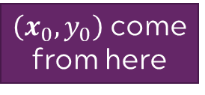
Use Average Test MSE to assess predictive capability
$\left(x_{0},y_{0}\right)$ come
from here
This is data the model has not seen.
What is Average Test MSE?
Take the $\left(x,y\right)$ values in the test set not used to fit the model
Call them $\left(x_{0},y_{0}\right)$
There should be “a lot” of them!
Compute Average ${\left(y_{0}−f\left(x_{0}\right)\right)}^{2}$
Notes:
In order to assess the predictive capability of the model, we will focus on an MSE calculation for the testing data instead of the training data. We will take all of the observations in our test data set and calculated the Average Test MSE which is a function of (actual data – predicted data). However, Average Test MSE is calculated on data the model has not seen before. This gives us that more objective look at model performance. We can consider various models and compare the Average Test MSE across the models, provided the models saw the same training, validation, and testing data sets.

Slide 46




Practical tips on assessing prediction
Got enough data for a test set? Great! Use the Average Test MSE!
NOT enough data for a test set? “I’ll just use training MSE.”
Can you use MSE if you lack a test data set?
NO! There is no guarantee that method with lowest training MSE will also have the lowest test MSE. Many statistical methods estimate coefficients to minimize the training data set MSE but do not produce the best predictive models on future observations.
Solution: Use a cross-validation method (involves estimating the test MSE from the training data)
Notes:
In the age of big data it might be hard to believe that we would suffer from a small sample size where we would not be able to divide our data into train, validate, and test data sets but it does happen.
So, what do you do in this situation? You certainly don’t skip the calculation of the Average Test MSE. Instead you use a different method to calculated Average Test MSE based on the training data. We will discuss these cross-validation approaches in some of our other models.
Transition: an important aspect of fitting predictive models is understanding the implications of underfitting and overfitting.

Slide 47
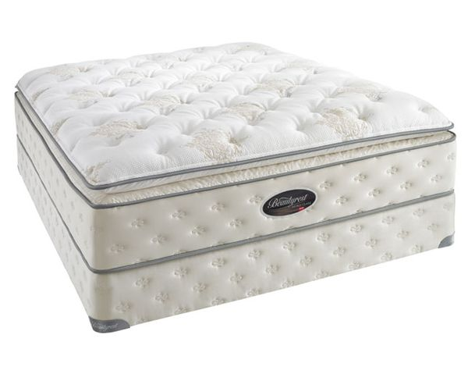
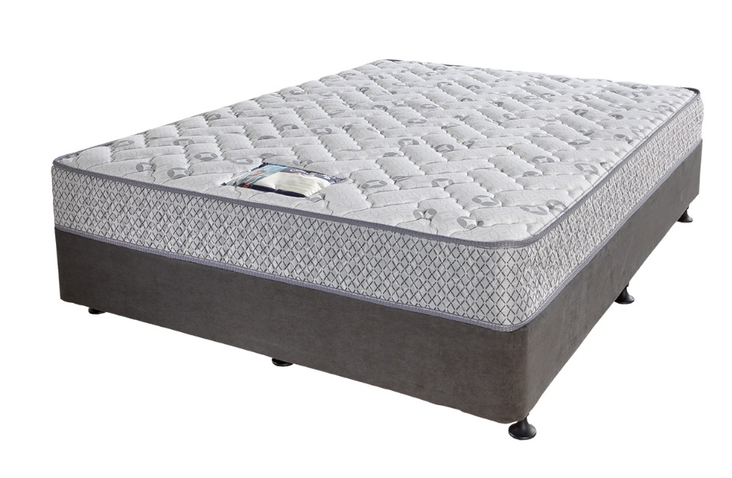
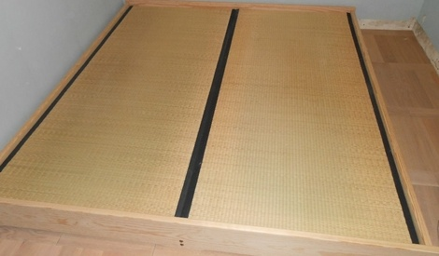
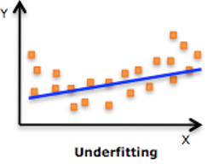
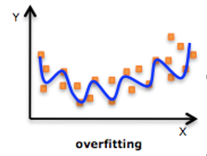
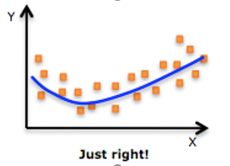
Goldilocks: The concepts of underfitting & overfitting
This bed is too hard!
This bed is too soft!
This bed is just right!
Notes:
Evaluating multiple models using Average Test MSE helps us prevent overfitting and underfitting. The fairy tale of Goldilocks and the Three Bears provides us with a nice analogy for the concept of underfitting and overfitting. When Goldilocks snuck into the Three Bears’ Cottage, she tried out all the beds in the and found Papa Bear’s bed was too hard, Mama Bear’s bed was too soft, and Baby Bear’s bed was just right.
If we underfit a model, it is like Papa Bear’s bed. It is too firm like a mat on the floor that doesn’t conform to our body at all. The model does not conform to the data like our line does not conform to the curve.
If we overfit a model, it is like Mama Bear’s bed. It is a pillow top mattress that conforms too much to the curves of our body. It captures every nuance of our data---Even the nuances that are just random error.
Overfitting and Underfitting give us poor representations of f(X).
Note that we can over fit in the functional form of our model or by adding too many Xs in regression or too many splits or layers to classification type models.
What we hope we get, is a mattress with just the right firmness. This means that our model captures the important trends but isn’t biased to the nuances of our training data so that our future predictions are compromised.

Slide 48
Compare training & test MSE when selecting a model
Test MSE
Linear regression – not flexible
Smoothing spline – most flexible
Smoothing spline – flexible balance
minimum possible Test MSE,
Var(ε),
irreducible error
True Model
Average Training MSE
number of parameters
Notes:
This chart has a lot of information on it but it captures the concepts of underfitting and overfitting very well by fitting some models to simulated data. In order to assess overfitting and underfitting we are going to focus on the relationship of the Test MSE and the Average Training MSE on the right hand panel of the chart. You should almost always expect training MSE to be less than test MSE as shown here.
The black curve is the true model used to simulate the open circle data points with some random error. Three machine learning algorithms were applied to the simulated (x, y) data points to estimate f or the black curve.
The gold line is the estimated function using linear regression. We can clearly see that gold line representing linear regression is a poor fit to the data. It has the highest training MSE and the highest average Test MSE in the plot on the right side of the slide.
The blue and green lines use 2 different smoothing spline fits (green is allowed to have more flexibility than blue). The spline functions are more flexible non-parametric models that we discussed earlier. But which one is best? If we focused solely on training MSE we would pick the green smoothing spline model because the training MSE is smallest for that model. Yet, when we evaluate it under the test data set, we are clearly overfitting. The test MSE increases for that model. We are capturing too many of the nuances in the data used to fit or train our flexible smoothing spline model so we don’t do well in a general sense when we predict on future observations. Remember the Test MSE is assessing prediction on these future observations.
The model that strikes a balance is the one with Test MSE and Average MSE are both relatively low and close together. In the decision between these three models, the blue flexible smoothing spline is the winner.
Note that comparisons of Training and Testing MSE are always relevant to the models under consideration. There is always the possibility that you might be able to improve on the model with additional features or a different ML algorithm.

Slide 49
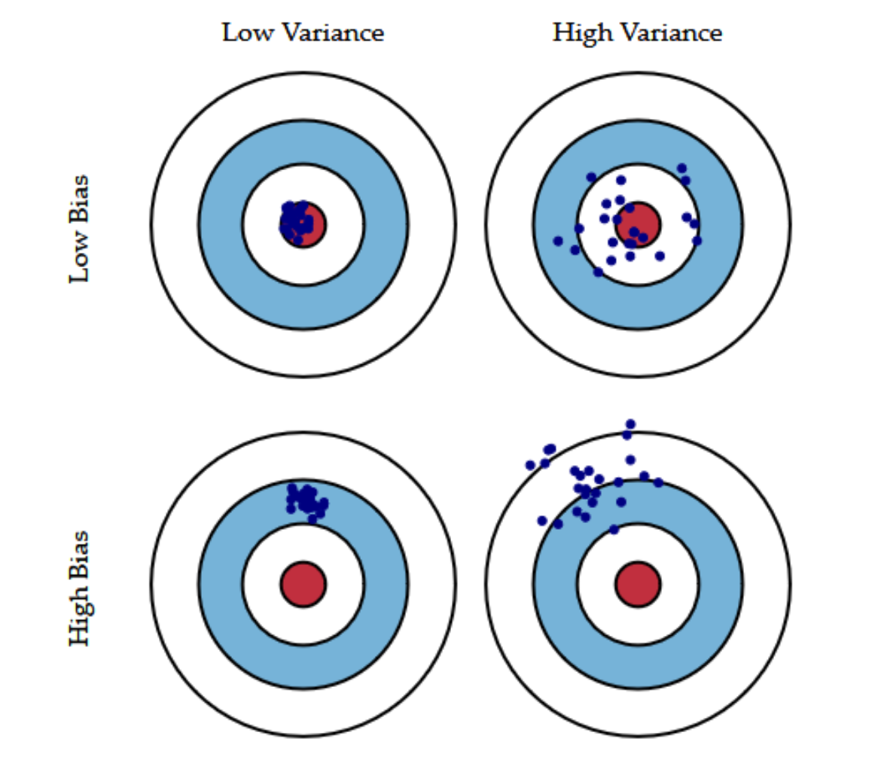
When selecting a model, keep in mind the bias-variance tradeoff
Bias is the difference between the predicted value and the expected value(distance of the blue points to the center)
Variance is the variability of model prediction for a given data point(a measure of scatter of the blue points)
High-variance methods are at risk of overfitting. In contrast, high bias methods typically produce simpler models that may fail to capture important regularities in the data
Notes:
High-variance learning methods may be able to represent their training set well but are at risk of overfitting to noisy or unrepresentative training data. In contrast, methods with high bias typically produce simpler models that may fail to capture important regularities in the data(comment)

Slide 50
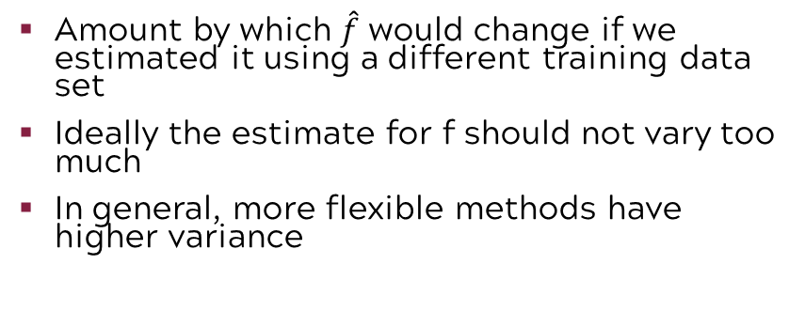
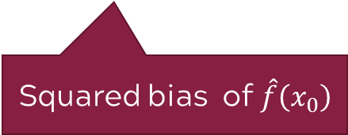
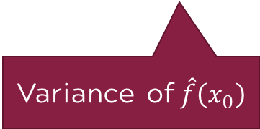
U-shape seen with the test MSE curve is the result of two competing properties of statistical methods
$$E{\left(y_{0}−\hat{f}\left(x_{0}\right)\right)}^{2}=Var\left(\hat{f}\left(x_{0}\right)\right)+{\left[Bias\left(\hat{f}\left(x_{0}\right)\right)\right]}^{2}+Var\left(ε\right)$$
Expected test MSE for given x₀
Variance of $\hat{f}\left(x_{0}\right)$
Squared bias of $\hat{f}\left(x_{0}\right)$
Irreducible error
To minimize expected test error, need to select a method that has low variance and low bias.
Amount by which $\hat{f}$ would change if we estimated it using a different training data set
Ideally the estimate for f should not vary too much
In general, more flexible methods have higher variance
Error introduced when we approximate complicated real-life problems with simpler models
E.g., linear regression assumes a linear relationship; if the relationship is non-linear, not possible to produce accurate estimate using linear regression
In general, more flexible methods have less bias
Notes:
When we think about the idea of the expected value of test MSE, we can break it into three parts. The reducible error is broken down into variance and squared bias. The third part of this expected test MSE for a given x is the irreducible error. Let’s focus in on the variance and the squared bias. Certainly the connotation of these words leads us to believe we would like them both the be small. Yet, in reality we will be forced to make trade-offs between the bias and the variance. This is another big idea of machine learning. Don’t worry so much about the math on this slide if the symbols don’t resonate with you. The most important take away is the understanding of the concept.
The variance can be described as the amount by which fˆ would change if we estimated it using a different training data set. Ideally, the estimate for f should not vary too much. As we have mentioned before, the more flexible methods have higher variance.
Bias occurs when we approximate complicated real-life problems with simpler models. You saw that on the previous slide when we fit the gold straight line to the black curve. Since the true underlying model represented by the black curve was not linear, it was not possible to produce accurate estimate using linear regression. In general, more flexible methods have less bias.
To minimize expected test error, need to select a method that has low variance and low bias.

Slide 51
Minimizing test MSE will minimize bias & variance
dashed horizontal line: minimum possible Test MSE, Var(ε), irreducible error
dotted vertical line: flexibility level corresponding to smallest test MSE
Challenge is to find a method for which both the variance and squared bias is low.
Keep in mind that a more flexible method will not always out-perform a simpler one.
Notes:
This slide illustrates the bias-variance tradeoff for three different known models. The maroon line is the MSE. The blue line is the bias and the gold line is the variance. We would like to minimize all three quantities on the vertical axis by selecting the model with the right amount of flexibility on the horizontal axis. Because we created the models, we know the true minimum possible test MSE which is represented by the horizontal dashed line. The vertical dashed line shows where all three of these are minimized in the models fit from our simulated training data. In practice we wouldn’t know this but it helps solidify this concept as we first introduce it.
In the left panel, we see our previous example. Note that the simplest model has low variance but really high bias. As the flexibility increases, we see an increase in variance and a decrease in bias. We minimize the variance and bias in the middle.
The middle panel shows that a simpler low degree polynomial that is close to straight line is the best fit.
In the right panel, we see that a more complicated model which captures the various inflection points is appropriate for this data.
We realize this is a lot of information to digest. However, the key take away is that you should select models that minimize test MSE which will in turn minimize bias and variance. Of course, remember minimizing test MSE does not protect you from bias or variance that might result from not having good data quality or data regarding specific phenomena that are important to your process. A new data collection plan and time are the only constructs that protect against those issues.

Slide 52
Introduction to Machine Learning
Notes:
Now we will introduce the concepts that build the foundation for evaluating models on categorical responses, often described as “classification models” in machine learning.

Slide 53
Supervised learning method selection is based on the response type
Is my response quantitative or qualitative?
Age
Height
Income
Stock Price
Tensile Strength
Quantitative
Qualitative
Blood Type
Default on Debt (y/n)
Cancer Stage
Brand Purchased
Species
Typically use regression method
Typically use classification method
Discrete: Nominal or Ordinal
Continuous Measures
What about the predictors?
For most methods, predictors can be
either quantitative or qualitative.
Notes:
Recall that classification methods to refer to any supervised learning model that helps us predict or make inferences about a categorical response.

Slide 54
In classification, we use accuracy to evaluate models
Example: Predicting the degree of dissatisfaction in the user experience of a new version of an app.
The diagonal of the confusion matrix is where the predicted classes accurately match the actual classes.
Any cell of the table on the off diagonal represents inaccurate predictions.
 |  | Actual
 |  | None | Low | Medium | High
Predicted | None | 111,382 | 1,097 | 9 | 0
 | Low | 2,361 | 9,704 | 358 | 9
 | Medium | 35 | 1,005 | 1,758 | 178
 | High | 0 | 33 | 355 | 938
Notes:
In classification models we are going to be concerned with the idea of accuracy so let’s take a look at a motivating example. In this example, we are predicting the degree of dissatisfaction in the user experience of a new version of an app. The table on the slide is often called the confusion matrix. We will do a deep dive into the confusion matrix and associated metrics in a subsequent module. For now, let’s just concentrate on the concepts of accurate and inaccurate classifications. The rows of the matrix represent the predictions and the columns represent the actual data. The majority of the individuals in this dataset lie along the diagonals and are accurately classified. These are highlighted in green with boxes around them. Any item off the diagonal is incorrectly classified. Of course, each of the misclassifications has a practical implication.

Slide 55
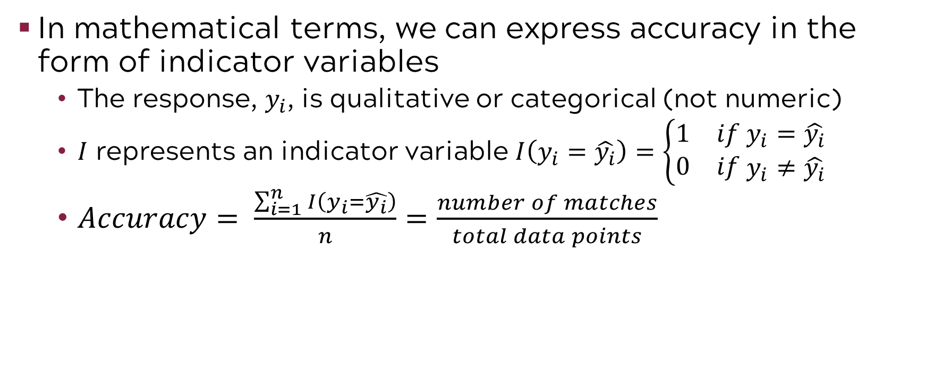
Accuracy is simply the proportion of matches
In mathematical terms, we can express accuracy in the form of indicator variables
The response, $y_{i}$, is qualitative or categorical (not numeric)
$I$ represents an indicator variable $I\left(y_{i}=\hat{y_{i}}\right)=\left\{\begin{aligned}\begin{matrix}1 & if y_{i}=\hat{y_{i}}\end{matrix} \\ \begin{matrix}0 & if \end{matrix}y_{i}≠\hat{y_{i}}\end{aligned}\right.$
$Accuracy= \frac{\sum_{i=1}^{n}{I\left(y_{i}=\hat{y_{i}}\right)}}{n}=\frac{number of matches}{total data points}$
Notes:
We show the mathematical expression for accuracy in the form of indicator variables here. The plain English definition of accuracy is much more clear when simply stated as the number of matches divided by the total data points.

Slide 56
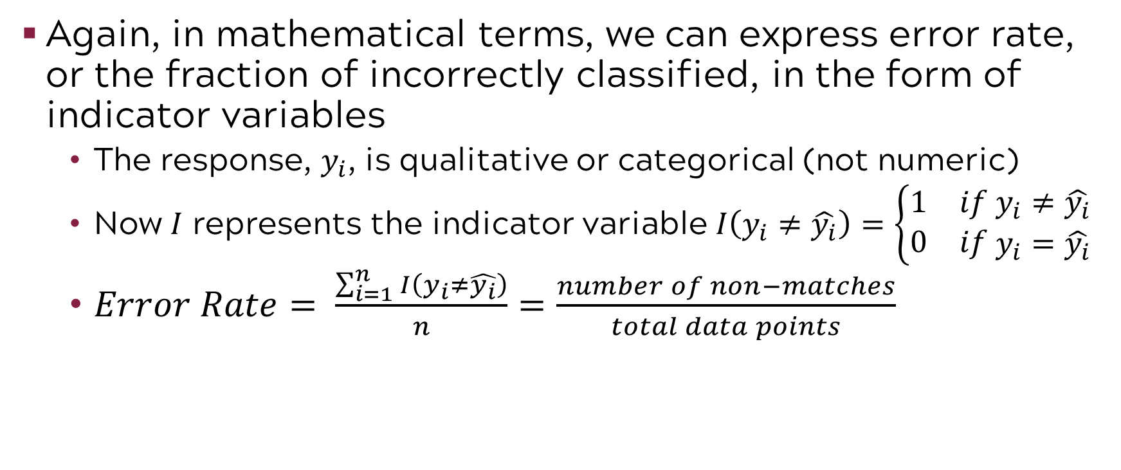
And error rate is the proportion of non-matches
Again, in mathematical terms, we can express error rate, or the fraction of incorrectly classified, in the form of indicator variables
The response, $y_{i}$, is qualitative or categorical (not numeric)
Now $I$ represents the indicator variable $I\left(y_{i}≠\hat{y_{i}}\right)=\left\{\begin{aligned}\begin{matrix}1 & if y_{i}≠\hat{y_{i}}\end{matrix} \\ \begin{matrix}0 & if \end{matrix}y_{i}=\hat{y_{i}}\end{aligned}\right.$
$Error Rate= \frac{\sum_{i=1}^{n}{I\left(y_{i}≠\hat{y_{i}}\right)}}{n}=\frac{number of non−matches}{total data points}$
This is the training error rate. Recall our model predictions in regression. What was our measure of prediction? The testing error rate. It is the same with classification.
Notes:
The Error Rate, or the Fraction Incorrectly Classified, is the number of non-matches divided by the total number of data points as expressed by the formula on the slide. If you recall the method for continuous responses, you will see a parallel in the evaluation of the classification models. We assess the Fraction Incorrectly Classified on our testing data set.

Slide 57
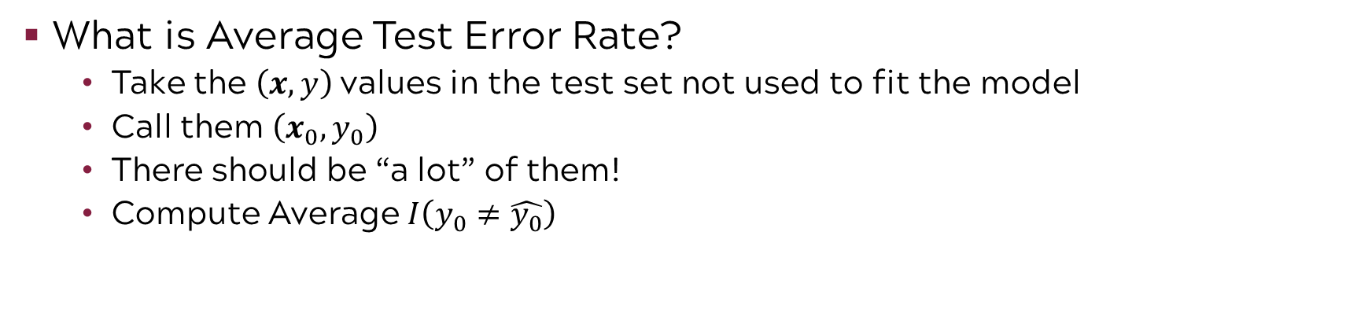
A good classification model is one with the smallest average test error rate
$\left(x_{0},y_{0}\right)$ come
from here
This is data the model has not seen.
What is Average Test Error Rate?
Take the $\left(x,y\right)$ values in the test set not used to fit the model
Call them $\left(x_{0},y_{0}\right)$
There should be “a lot” of them!
Compute Average $I\left(y_{0}≠\hat{y_{0}}\right)$
Notes:
Let’s revisit the Train-Validate-Test paradigm. Remember, we are interested in the quality of our classification model on future predictions. We divide our data set into three parts, Train, Validate, and Test. For the classification model, we will focus on the average test error rate on the test data also known as the average test fraction incorrectly classified to evaluate our models. Again, this is analogous to selecting the model that minimizes the average test MSE in a continuous case. To reiterate, when we evaluate Test Error Rate, we are evaluating the error rate on data the model has not seen before that is in the test data set.

Slide 58
A simple classification of gold and blue
100 simulated data points – 2 classes, gold and blue
We fit the optimal classifier (because we can on simulated data). It is called the Bayes classifier (more on this later!).
It classifies points as gold or blue based on the X values.
The Bayes Error Rate for this data is = 0.1304. Remember this number!
Notes:
Let’s introduce a simple classification model of gold and blue which contains 100 simulated data points. Because we know the model, we can fit the optimal classifier which is the Bayes classifier. Based on the values of X1 and X2, the classifier determines which data point should be gold and which should be blue. The Bayes Error rate for this data is 0.1304. That is the number to beat.

Slide 59
K nearest neighbors (KNN) is often used to classify real data
KNN often gives results close to the optimal Bayes classifier.
KNN with k=3 method to classify X:
Select the k=3 points nearest to X. These three points represent the neighborhood.
What fraction of those points are blue? (Probability of being blue) What fraction is gold? (Probability of being gold)
Classify X as blue if the majority of the points in the neighborhood are blue. Classify X as gold if the majority of the points are gold
Note: We will complete a more detailed overview of this method in our classification module.
Notes:
Now, we will introduce the concept of K nearest neighbors or KNN classifier. Note that KNN is a non-parametric classifier that provides a lot of flexibility but not a lot of interpretability. It focuses on prediction. This is a well-tested classifier that often gives us results close to the optimal Bayes classifier. That’s important when working with real data where we can’t calculate the optimal classifier like we can in our simulated data set. The concept of k nearest neighbors is really simple. First you define k. In this case, k is three. That is our “neighborhood size”. You pick a data point. You look at the three data points closest to it based on a mathematically defined measure of distance. Within those k data points, the 3 data points in this case, you determine how many are gold and how many are blue. If the majority of the data points are blue then your classify as blue. If the majority of points are gold then you classify as gold.
To resolve ties in KNN classification, several strategies can be applied:
Odd Numbers for k - Using an odd k value ensures a majority, preventing ties.
Random Tie-Breaking - Randomly selecting a class when a tie occurs, though introducing an element of chance.
Leveraging Prior Probabilities - Selecting the more frequent class in an imbalanced dataset.
Selecting the Closer Neighbor - Choosing the class of the closest neighbor among the tied options.
Using Weighted Distances - Giving more influence to closer neighbors, which helps refine the prediction.

Slide 60
The concepts of overfitting & underfitting are still applicable in classification models
Underfit with K=100
Just right with K=10
Overfit with K=1
Less Flexible
High Bias, Low Variance
Test error rate = 0.1925
Test error rate = 0.1363
Bayes error rate = 0.1304
Flexible
Low Bias, High Variance
Test error rate = 0.1695
Notes:
Just as in the continuous case with regression, you have the possibility to underfit or overfit a classification model as well. If you underfit the model by picking a really large value of k, such as K=100 on the left, you see almost a straight-line classifier defined by the solid black line. Contrast this with the classifier on the right where k=1. This classifier has lots of detail. It looks like a very wavy coastline map with lots of inlets. In this case we are only using one data point closest to X to make the classification. The classifier on the left is less flexible and has high bias but low variance which are classic characteristics of underfitting. The classifier on the right has low bias but high variance which are classic characteristics of overfitting. The classifier in the middle is “just right”. It strikes the balance with that bias-variance tradeoff. The Test Error Rate for K=10 KNN model is 0.1363 which is very close to our number to beat, the Bayes error rate of 0.1304. Note the test error rates for the other models are larger than the optimal number of 0.1304.

Slide 61
Compare training & test error rates when selecting a model (same concept as regression)
Test error rate
(n= 5,000)
Bayes error rate
Training error rate
(n=200)
less flexible, underfit
K is higher, more neighbors, K=100
more flexible, overfit
K is lower, fewer neighbors, K=1
“Just Right” K=10
Notes:
This slide plots the test error rate and the training error rate with the benchmark of the Bayes error rate shown as the dotted horizontal line. The X-axis is 1 over K so K=1 corresponds to 1, K=10, corresponds to 0.1, and K=100, corresponds to 0.01. The left side shows the underfit model with high training and high test error rate. The right-hand side shows the overfit model with K=1 where there is a large departure in the training and testing error rates. Note the test error rate begins to climb with overfitting indicating we don’t predict well on data that was not in the sample. The “Just Right” model is in the middle at K=10 where the test error rate hits its minimum.
Of course, in practice, we won’t know our optimum error rate as defined by the dashed horizontal line. However, this toy example illustrates the importance of minimizing the test error rate in order to select the most appropriate model. As a manager you want to question your analyst regarding this practice when they present you with a final model.

Slide 62
Introduction to Machine Learning

Slide 63
Introduction to Machine Learning Course Roadmap
What is the goal of the data analysis?
Predict an output |  |  |  |  |  | Reveal patterns or relationships |  | Make decisions using an autonomous agent
Supervised Learning (Output in the data set) |  |  |  |  |  | Unsupervised Learning (No output in the data set) |  | Reinforcement Learning* (Supervised & unsupervised)
Continuous or discrete output? |  |  |  |  |  | What is the subgoal? |  | Does a model exist?
Continuous |  |  | Discrete |  |  | Identify groups | Reduce dimensions | Model Based | Model Free
Simple linear regression Multiple linear regression Subset selection Ridge regression & LASSO PCR & PLS | Polynomial regression Step functions Splines Local regression General additive models | Decision tree Random forest Neural network Gradient boosting tree | Logistic regression Linear discriminant analysis Quadratic discriminant analysis | Decision tree Random forest Neural network Gradient boosting tree | Support vector machines | Hierarchical clustering K-means clustering | Principal components analysis | Given the model Learn the model | Policy Optimization Q-Learning
*Advanced Topic: Bonus module if time

Slide 64
Now you should be able to:
Describe general applications of machine learning
Explain the difference between supervised and unsupervised learning
Explain the “train, validate, test” paradigm
Key point: When we evaluate the predictive capability of models, we will always use average TEST MSE and average TEST error rate.
Identify the tradeoffs between flexibility and interpretability
Describe the consequences of overfitting and underfitting
Identify overfitting and underfitting on plots of training and testing error rates

